Slide 1

Introduction to Cloud Computing
Week 7
Azure Cloud Networking, Storage & Database
CS-4037
Muhammad Sudais
muhammad.sudais.v@nu.edu.pk

Slide 2
CHAPTER 4 Microsoft Azure CLOUD NETWORKING
|LEARNING MICROSOFT AZURE

Slide 3
Microsoft Azure Cloud Networking
"Azure networking is essential to any public cloud; it allows us to bring both on-premise and cloud networks together.“
— Ryan O'Connell, Microsoft Azure MVP
Key Points:
Scale resources to meet demands
Compliance, security, cost efficiency
Flexibility to adapt to current and future demands

Slide 4
Introduction to Azure Networking
Azure Networking Overview:
Fully managed and scalable networking services
Connects on-premises data centers to the cloud
Build secure virtual network infrastructure
Manage traffic and protect from DDoS attacks
Enable secure remote access globally

Slide 5
Azure Networking Services Categories
Services for Connectivity
Services for Application Protection
Services for Application Delivery
Services for Network Monitoring

Slide 6
Azure Networking for Connectivity
Network Connectivity Services:
Azure Virtual Network (VNet)
ExpressRoute
Virtual WAN
VNet Peering
VPN Gateway
Azure Bastion
Azure DNS

Slide 7
Azure Networking for Application Protection
Application Protection Services:
Azure Load Balancer
Azure Firewall
VNet Endpoints
Private Link
DDoS Protection

Slide 8
Azure Networking for Application Delivery
Application Delivery Services:
Azure Content Delivery Network (CDN): Global content delivery
Azure Front Door: Web traffic routing
Azure Traffic Manager: Load balancing across regions
Application Gateway, Internet Analyzer

Slide 9
Azure Networking for Monitoring
Network Monitoring Services:
Network Watcher
ExpressRoute Monitor
Azure Monitor
VNet Terminal Access Point (TAP)

Slide 10
Azure Networking for Connectivity - OVERVIEW
Azure Networking for Connectivity Purpose:
Simplifies the process of building, securing, and managing network infrastructure
Connects applications, scales efficiently, and ensures compliance
Supports hybrid cloud models, connecting on-premises resources to the cloud securely

Slide 11
Azure Virtual Network (VNet)
Features of Azure VNet:
Build secure, private network infrastructure
Communicate with on-premises networks and external resources
Filter and route traffic with Network Security Groups (NSGs) and firewalls
Attach multiple network interfaces (NICs) to Azure VMs

Slide 12
Azure Virtual Network Peering
VNet Peering:
Connect multiple virtual networks securely
Uses Microsoft's private infrastructure
Global VNet Peering: Connect virtual networks across regions
Gateway Transit: Use the VPN gateway of a peered network for cross-premises connectivity

Slide 13
Azure Virtual Wide Area Network (WAN)
Azure Virtual WAN Overview:
Managed networking service for connectivity, security, and routing
Features:
Branch connectivity with SD-WAN/VPN
Site-to-site and point-to-site VPN
ExpressRoute for private connectivity
Remote user access for work-from-home scenarios
Hub and spoke architecture

Slide 14
Azure ExpressRoute
ExpressRoute Overview:
Private connection between on-premises networks and Azure
Bypasses the public internet for improved security and speed
Connect with Microsoft services like Azure, Microsoft 365, Dynamics 365
Connectivity Models:
Cloud Exchange Co-location
Point-to-Point Ethernet
Any-to-any (IPVPN)
ExpressRoute Direct (10–100 Gbps direct connection)

Slide 15
ExpressRoute Use Cases and Features
Key Use Cases:
High-speed, reliable, private network connections
Integration with Microsoft Azure, Microsoft 365, Dynamics 365
Features:
Support for different connection models
ExpressRoute Global Reach: Connect branch offices globally

Slide 16
Network Security and Traffic Routing
Traffic Routing and Filtering:
Use NSGs to control inbound/outbound traffic
Network security appliances available on Azure Marketplace
Implement firewalls and WAN optimization through virtual network appliances

Slide 17
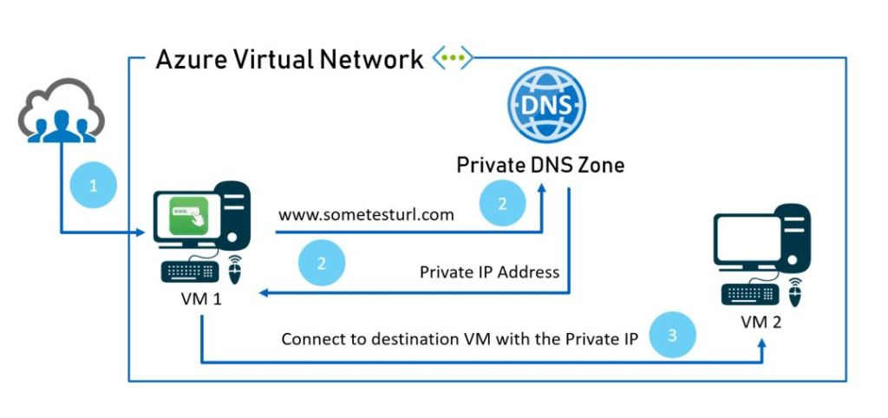
Azure Domain Name System (DNS)
Overview:
Azure DNS is a hosting service for DNS domains
Provides name resolution using Microsoft Azure infrastructure
Manage DNS records with the same credentials, APIs, and tools as other Azure services
Key Features:
Reliability and good performance
Fast DNS query responses by using the closest available DNS server
Hosted on Azure’s global DNS network, ensuring high availability
Secure management linked with Azure Resource Manager and Azure RBAC

Slide 18
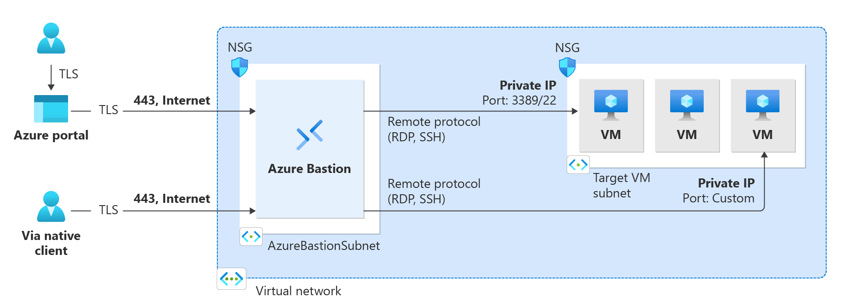
Azure Bastion Overview
What is Azure Bastion:
Fully managed PaaS service for secure VM connections
Enables seamless RDP/SSH connectivity directly in the Azure portal over TLS
VMs do not require a public IP address
Key Benefits of Azure Bastion:
No need for RDP/SSH ports exposed to the public internet
VMs are securely connected within their virtual networks
Supports RDP and SSH directly in a web browser (HTML5-based)

Slide 19
Azure Services for Application Protection
Azure offers a suite of networking services that help secure your cloud applications and workloads.
These services ensure that network resources are safeguarded against potential threats and attacks.

Slide 20
Azure Firewall
Azure Firewall is a fully stateful firewall service that provides threat protection for cloud workloads.
It offers high availability and scalability, and it's available in two primary tiers:
Azure Firewall Standard:
Offers Layer 3 to Layer 7 firewall filtering
Integrates with Microsoft Cyber Security threat intelligence to protect against malicious traffic.
Azure Firewall Premium:
Includes advanced features such as signature-based intrusion detection and prevention system (IDPS) for identifying specific attack patterns and provides support for third-party integrations.
You can centrally manage these firewalls across multiple subscriptions using Azure Firewall Manager, which simplifies security and route management across virtual networks (VNets) and Virtual WANs.

Slide 21
Azure DDoS Protection
Azure DDoS Protection shields your applications from distributed denial of service (DDoS) attacks, which can severely disrupt your resources.
Azure DDoS Protection Standard: Offers advanced DDoS mitigation and provides support through Azure DDoS Rapid Response during active attacks.

Slide 22
Azure Private Link
Azure Private Link allows secure access to Azure PaaS services (e.g., Azure Storage, SQL Database) through private endpoints in your virtual network.
It ensures that traffic between your virtual network and the service stays on the Microsoft backbone, eliminating the need for public internet exposure.

Slide 23
Web Application Firewall (WAF)
Azure WAF protects web applications from common vulnerabilities like SQL injection and cross-site scripting:
It comes pre-configured with rules addressing the vulnerabilities.
WAF can be deployed with either Application Gateway for regional protection or Azure Front Door for network-edge protection.

Slide 24
Network Security Groups (NSGs)
NSGs are built-in Azure tools for controlling inbound and outbound traffic at both the subnet and network interface card (NIC) levels.
They allow you to create security rules that define which traffic is permitted or denied to specific resources.

Slide 25
Azure Load Balancer
Azure Load Balancer distributes traffic across virtual machines (VMs) to ensure high availability and scalability. There are two types:
Public Load Balancer: Handles public-facing traffic.
Internal Load Balancer: Manages traffic within your virtual network.

Slide 26
Azure Networking Services For Application Delivery
Overview:
Application delivery improves speed, reliability, and user experience for cloud-hosted apps.
Azure provides a range of services like Azure Front Door, Azure CDN, and Application Gateway.
These services ensure global scalability, faster content delivery, and security for apps.
Key Azure App Delivery Services:
Azure Front Door: Fast, scalable entry point for web applications.
Azure Application Gateway: Load balancing for web traffic with enhanced security.
Azure Traffic Manager: DNS-based load balancer for global distribution.
Azure CDN: Caches content globally for faster delivery to users.

Slide 27
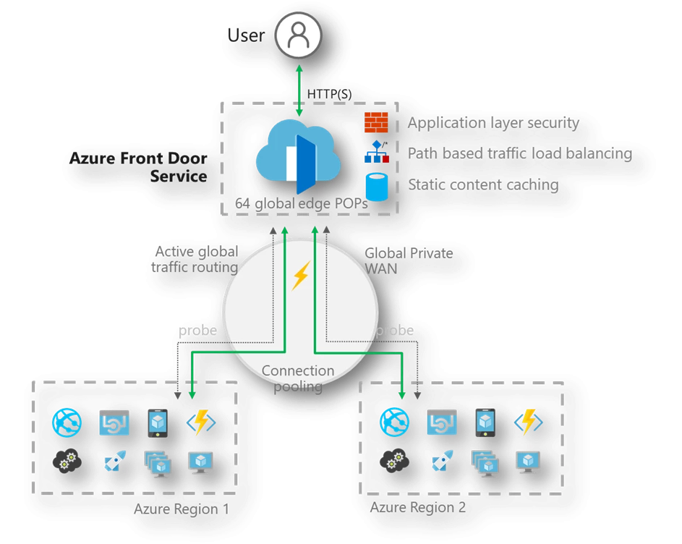
Azure Front Door
Overview:
Provides a global, scalable entry point to ensure that web applications are delivered quickly to users worldwide.
Benefits:
Cookie-based session affinity, SSL offloading, and support for custom domains.
Web Application Firewall (WAF) integration
HTTP/HTTPS redirection
Smart monitoring to track backend resources and IPv6 connectivity.
Azure Front Door is available in Standard and Premium tiers, which vary in features and performance optimization.

Slide 28
Azure Application Gateway
Overview:
Enables advanced traffic management for web applications.
Provides autoscaling based on traffic load.
Features zone redundancy and high availability.
URL-based routing, multiple site hosting, and SSL termination.
Benefits:
Web traffic load balancing with integrated WAF.
Can be used as an ingress controller for Azure Kubernetes Services (AKS).
Support for multiple availability zones and integration with Azure Monitor.

Slide 29
Azure Traffic Manager: DNS-based Traffic Balancer
Overview:
Distributes traffic globally for high availability.
Supports hybrid cloud and on-premise endpoints.
Allows custom traffic-routing methods: Priority, Weighted, Geographic, etc.
Supports failover and improved performance through low-latency routing.
Benefits:
Scalable traffic management for hybrid environments.
Nested profiles for complex deployments.
Low-latency, multi-region performance improvements.

Slide 30
Azure CDN: Global Content Delivery Network
Overview:
Caches high-bandwidth content for faster delivery.
Uses closest POP server for content acceleration.
Integrates with Azure Blob storage and other web servers for static asset caching.
Benefits:
Enhanced performance for global users.
Scales to handle high traffic load.
Supports custom domain mapping and CDN caching of web content.
Query string-based caching available.

Slide 31
Choosing the Right Service for Your Needs
Choosing the Right Service for Your Needs:
Azure Front Door: Best for fast global delivery of dynamic web applications.
Azure Application Gateway: Ideal for web traffic load balancing and security.
Azure Traffic Manager: Use for DNS-level routing across multiple regions.
Azure CDN: Perfect for caching and delivering static content.

Slide 32
Azure Networking Services For Network Monitoring
Azure provides a wide range of networking services that help monitor, diagnose, and maintain cloud resources.
Focuses on monitoring network resources in Infrastructure as a Service (IaaS) environments.
Expands beyond traditional networking with innovations in Azure Space.
Key Concepts:
Network Health Monitoring
Diagnostic and Traffic Tools
Space-Based Networking Solutions

Slide 33
Azure Network Watcher
A service providing tools for monitoring and diagnosing networking issues in Azure Virtual Networks.
IaaS focus, monitoring resources like:
Virtual Machines (VMs)
Application Gateways
Load Balancers
Virtual Networks (VNets)
Key Features:
VM and Endpoint Monitoring: Track communication between VMs and other network endpoints & Set alerts and receive notifications on issues.
Network Visualization: Visualize the overview and relationship of resources within a VNet.
Traffic Filtering Detection: Troubleshoot network traffic filtering problems between VMs.
Routing and Connection Diagnostics: Diagnose issues related to network routing and outbound connections.
Packet Capture: Capture and analyze network traffic for anomalies.
Limitations:
Not Compatible with Web Analytics:
Focuses primarily on IaaS, doesn’t monitor PaaS or web apps.
Not Suitable for PaaS Monitoring:
Cannot be used for Azure App Services, databases, or other platform services.

Slide 34
Azure Monitor Network Insights
Part of Azure Monitor.
Provides centralized health monitoring and metrics tracking for all deployed network resources.
Allows users to track networking metrics across VNets, NSGs, load balancers, etc.
Key Components:
Network Health: Provides a unified view of the health status of all network resources & set up alerts, filters, and dependency views.
Connectivity Monitoring: Use Connection Monitor to test and visualize network connectivity.
Traffic Analysis: View NSG flow logs and traffic analytics across different subscriptions and regions.
Diagnostic Toolkit: IP flow verification, network path tracing, packet capture for troubleshooting.

Slide 35
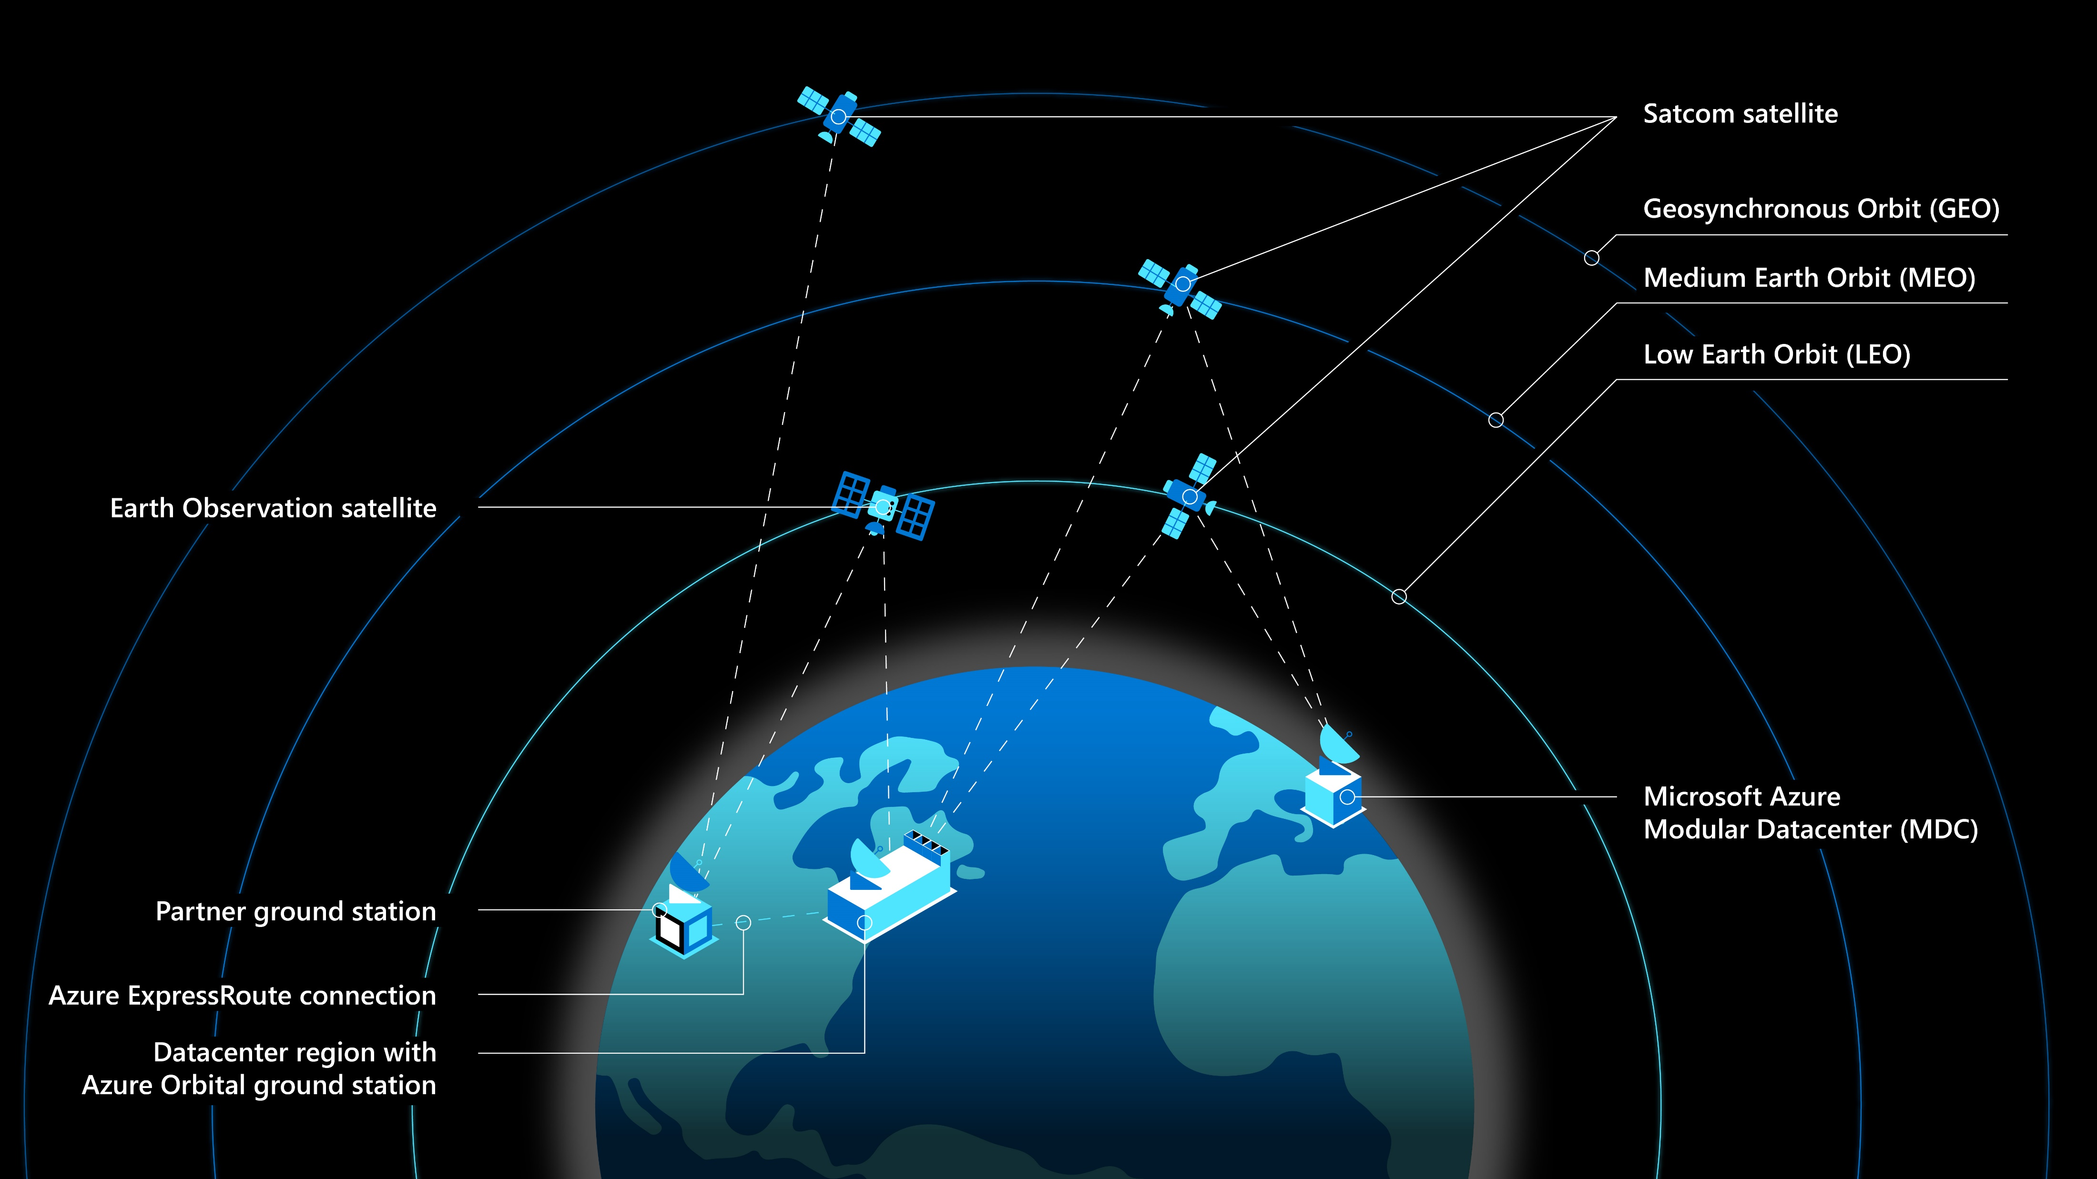
Azure Space: Networking Beyond the Clouds
Key Services:
Azure Orbital
Azure Orbital Emulator
Azure Modular Data Center (MDC)
Overview:
Azure Space is an advanced Azure offering extending cloud services to space.
Created to connect space-based resources with the Azure cloud ecosystem.

Slide 36

Azure Orbital
What is it?
A fully managed ground station service allowing satellite communication and control.
Facilitates downlinking, scheduling, and satellite operations through Azure.
Data Processing:
Satellite data processed and securely transferred via Azure Virtual Network.
Store data in Azure Storage or other Azure services.
Use Cases:
Global communications, earth observation, weather tracking.

Slide 37
Azure Orbital Emulator
What is it?
Simulation tool for testing satellite applications using AI algorithms.
Allows developers to simulate satellite networking before deploying satellites.
Benefits:
Test satellite applications in the cloud to reduce deployment risks.
Simulate complex satellite constellations and networks.

Slide 38
Azure Modular Data Center (MDC)
What is it?
A portable, self-contained data center unit designed for remote and challenging environments.
Offers full Azure cloud services in locations with limited connectivity.
Use Cases:
Military operations
disaster recovery
off-grid industries.
Connectivity:
Fully equipped with secure network connectivity, including satellite communication.

Slide 39
CHAPTER 5 Microsoft Azure Cloud Storage & Databases
|LEARNING MICROSOFT AZURE

Slide 40
Introduction to Microsoft Azure Cloud Storage and Databases
"Choosing the right database and data storage options can mean the difference between a resilient, scalable, and delightful application...and one that is not.“
Key Needs:
Access data anytime, anywhere.
Scalable storage solutions.
Data retention policies for security and compliance.
Azure’s tools help manage structured and unstructured data effectively.
Key Benefits:
Scalability: Easily upgrade storage capacity on demand.
Security: Reliable, secure data storage.
Global Access: Data accessible anywhere.
Cost Savings: No need for physical servers.
Data Synchronization: Easy sharing across devices.
Disaster Recovery: Quick data backup and restoration.

Slide 41
UNDERSTANDING DATA
Understanding Big Data:
Large volumes of complex, heterogeneous data that businesses analyze to improve strategies.
Managing this data requires specialized storage and processing techniques.
Types of Data:
Structured Data:
Organized in tables with relationships.
Examples: SQL Server, Oracle, MySQL.
Suitable for CRUD operations.
Unstructured Data:
No predefined format.
Examples: Video files, social media posts.
Best stored in NoSQL databases or Azure Data Lake.

Slide 42
Azure Storage Overview
Key Features:
Scalable and durable.
Accessible via HTTP, HTTPS, and REST API.
Offers data replication across geographic locations for disaster recovery.
Can be managed via Azure Storage Explorer.
Azure Storage Account Types:
Azure Storage v1 and v2:
Different capabilities for varied storage needs.
Choose based on your organization’s specific use case.
Tools for Managing Azure Storage
Azure PowerShell, Azure CLI for automation.
Client libraries for API development in C#, Java, Python, etc.
Azure Storage Explorer for data administration.
Scalability and Disaster Recovery with Azure Storage
Scalability: Expand storage based on demand.
Disaster Recovery: Replicate and back up data across Azure’s global data centers.

Slide 43
Azure Databases OVERVIEW
Overview:
Fully managed cloud database services.
Supports both relational (SQL) and non-relational (NoSQL) databases.
Ideal for modern cloud application development.
Structured Databases
Relational Databases:
SQL Server, Oracle, Postgres, Azure SQL.
Used for structured data requiring relationships (e.g., customer records).
Non-Structured Databases
NoSQL Databases:
Ideal for unstructured data like documents, videos, logs.
Examples: Azure Data Lake, Cosmos DB.
Use Cases for Azure Database Services
Relational Databases: Suitable for applications that need structured, transactional data.
NoSQL Databases: Ideal for handling large, diverse datasets.

Slide 44
Azure Storage Services
Cloud-based storage solutions for various types of data
Service types vary depending on data needs
Azure Storage services update frequently (refer to Azure updates)
Azure Storage Service Options
Azure Blob Storage: Massive scalable object store
Azure Files: Managed file storage with SMB and NFS
Azure Queues: Secure message storage for applications
Azure Tables: NoSQL store for structured data
Azure Managed Disks: Block-level storage for IaaS

Slide 45
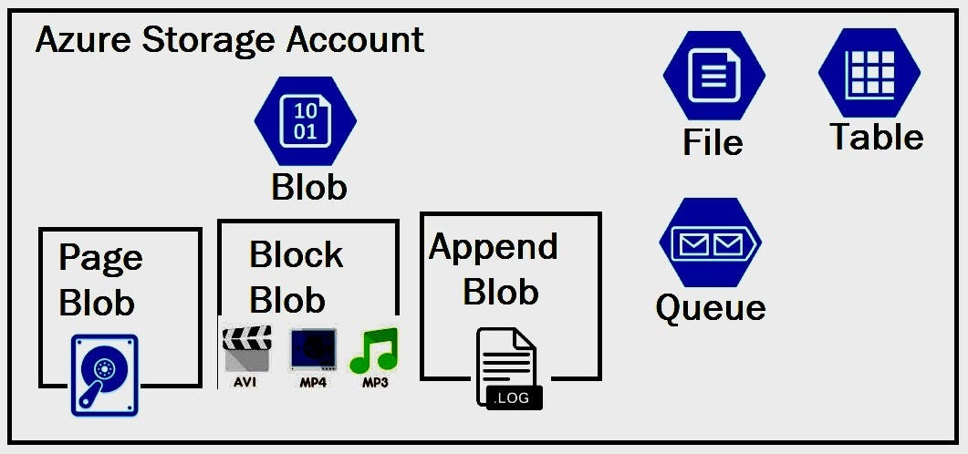
Azure Blob Storage
Cloud-based object storage for binary data (text, video, audio)
Ideal for:
Storing files for distribution
Streaming videos/audio
Backup and archiving
Azure Blob Storage Components
Storage Account: Unique namespace and URL for data objects
Containers: Organizes blobs, like folders in a file system
Blobs: Types - Block, Append, Page
Block: Text and binary data (up to 190.7 TiB)
Append: For append operations (e.g., logging)
Page: Random access files (up to 8TB)
Accessing Azure Blob Storage:
Accessible globally via HTTPS
Supported languages: .NET, Java, Python, Node.js, Ruby, PHP
Access methods: REST APIs, Azure CLI, PowerShell
For naming conventions, refer to Microsoft documentation

Slide 46
Azure Files
Managed file shares in the cloud (SMB, NFS protocols)
Accessible by cloud or on-premises deployments
SMB shares work on Windows, Linux, and macOS
Supports caching with Azure File Sync for faster access
Azure Files Use Cases and Benefits:
Replace on-premises file servers
Migrate applications to the cloud
Persistent volume for containerization
Simplify cloud development

Slide 47
Azure Queue Storage
Service for storing large numbers of messages in the cloud
Key Components:
URL Format: storageaccountname.queue.core.windows.net
Storage Account: Namespace for queue messages
Queue: Stores a set of messages
Message: Up to 64 KB in size, customizable time-to-live (TTL)

Slide 48
Azure Table Storage
NoSQL storage for large sets of structured data
Ideal for:
Handling terabytes of structured data
Easy denormalization of datasets
Fast data queries with clustered indexing
Azure Table Storage Components:
Storage Account: Required for all access
Table: Collection of entities (schema-less)
Properties: Entities have up to 252 properties
System properties: Partition key, Row key, Timestamp
Row key ensures uniqueness within a partition

Slide 49
Azure Managed Disks
Virtualized cloud storage for IaaS
Supports ultra disks, SSDs, and VM Scale Sets
Scalable and secured with high availability (99.999%)
Benefits of Azure Managed Disks
Durability: Replicated data for availability
VM Deployments: Scalable with 50,000 disks per region
Security: Role-based access control (RBAC), encryption

Slide 50
Azure Storage Security Best Practices
Use shared access signatures (SAS) with caution
Consider encryption
Consider RBAC for additional security layers

Slide 51
Azure SQL as a Fully Managed Service
Introduction: Azure SQL Database is a fully managed Platform-as-a-Service (PaaS) relational database.
Features:
Automatic backups, updates, and patching
Built-in high availability with 99.99% SLA
AI-powered performance recommendations
Why Choose Azure SQL?
No need for manual database management.
Optimized for cloud applications with elastic scaling.

Slide 52
Azure SQL Deployment Options
SQL Server on Azure Virtual Machines (VMs): Full control over SQL Server instance for lift-and-shift scenarios.
SQL Managed Instance: Near 100% compatibility with on-prem SQL Server, with cloud-native features.
SQL Database: Fully abstracted serverless model with Hyperscale and autoscaling for cloud-native apps.

Slide 53
SQL Server on Azure Virtual Machines (IaaS)
This option allows businesses to run SQL Server on Azure VMs
suitable for those already familiar with SQL Server.
Azure manages security patches and backups
users are responsible for maintaining the OS and SQL Server software.

Slide 54
SQL Managed Instance (PaaS)
Offers most SQL Server features without needing to manage virtual machines.
This is ideal for businesses looking to save on infrastructure costs while retaining SQL Server’s instance-scoped features.

Slide 55
SQL Database (PaaS)
Abstracts the server management completely.
Allows businesses to focus purely on application development.
Supports hyperscale for large storage.
Supports geo-replication for global reach.
Supports autoscaling for unpredictable workloads.
Offers a high availability SLA and intelligent performance management.

Slide 56
Azure Cosmos DB: Global No-SQL Database
Description: Azure Cosmos DB is a globally distributed, fully managed NoSQL database service.
Global Scale: Geo-replication enables distribution of data across multiple Azure regions.
Multi-Model Support: Supports document, key-value, graph, and column-family data models.
Performance: Single-digit millisecond latency and 99.999% availability for multi-region deployments.

Slide 57
Benefits of Azure Cosmos DB
Scalability: Elastic scaling of throughput and storage based on demand.
Global Distribution: Automatic replication to any Azure region for global access.
High Availability: 99.999% availability with multi-region replication and disaster recovery.
Flexible Consistency Models: Five well-defined consistency levels from strong to eventual consistency.

Slide 58
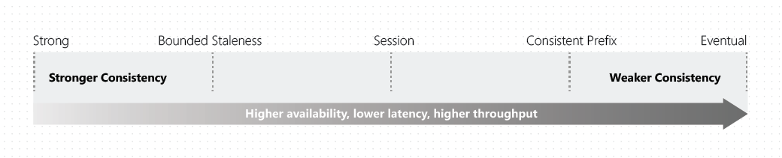
Consistency Levels in Cosmos DB
Strong Consistency: Linearizability for the most recent committed writes.
Bounded Staleness: Reads lag behind writes by a defined period or versions.
Session Consistency: Ensures monotonic reads and writes within a session, great for user-specific data.
Consistent Prefix: No out-of-order reads.
Eventual Consistency: Lowest latency but no up-to-date reads guarantee.

Slide 59
Cosmos DB APIs
Core (SQL) API:
For document-based data with SQL syntax queries
Ideal for migrating from traditional databases like Oracle or DynamoDB.
Gremlin API:
For graph-based data, useful for complex relationships, such as social networks or IoT data.
MongoDB API:
Enables use of existing MongoDB applications with minimal changes.
Cassandra API:
Supports column-oriented data storage and scales horizontally for large datasets.
Table API:
A key-value store that works well with OLTP scenarios
Can migrate from Azure Table Storage with minimal effort.

Slide 60
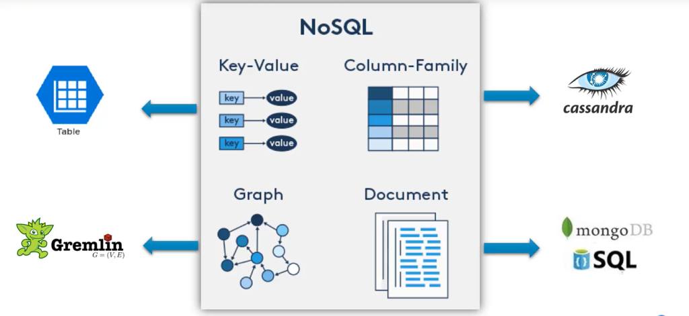
COSMOS DB APIS

Slide 61
Global Distribution and Replication in Cosmos DB
Elastic Global Scale: Distribute data automatically across multiple regions for low-latency access.
Multi-Homing: Data available in every region, apps access nearest region automatically.
Region Changes: Region changes handled without app interruption, with multi-region writes for enhanced availability.

